Slide 1
Skybank
Taking over home banking
Notes:
David

Slide 2
Technologies
Frontend
HTML
CSS
React
TypeScript
Redux
Axios
JavaScript
Backend
Java
PostgreSQL
Maven
Javalin
Dbeaver
JDBC
Notes:
Josiah

Slide 3
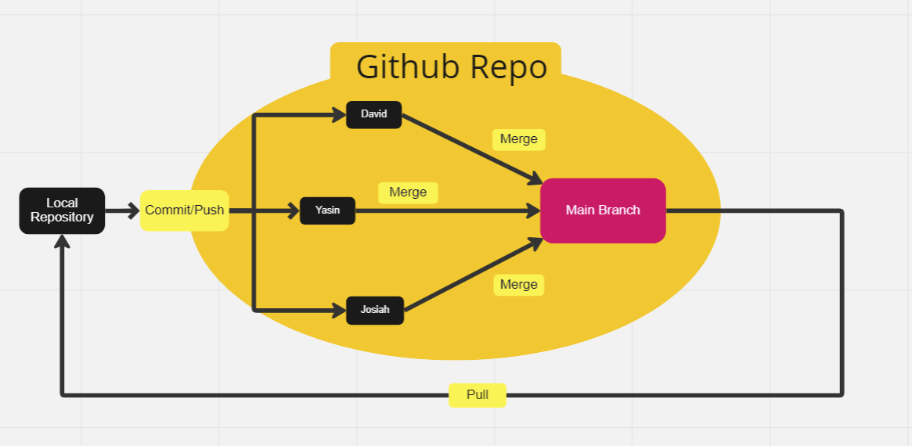
GitFlow
Notes:
Yasin

Slide 4
Team Structure
David: GitFlow, Frontend
Yasin: Fullstack
Josiah: Backend
Notes:
David

Slide 5
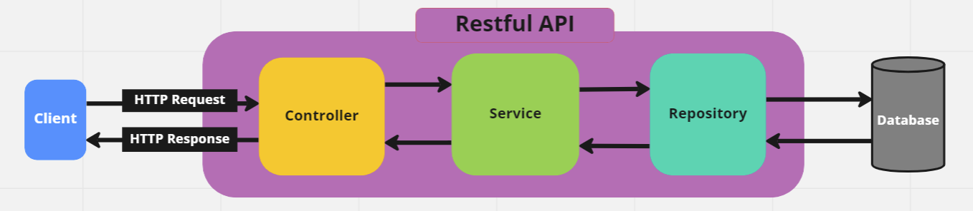
Architecture Diagram
Notes:
Josiah

Slide 6
Agile/Scrum Implementation
Daily Standup
Updated Trello Board
Story points
Spring Planning (figma)
Sprint Review (meeting with client)
Working Software (JDBC over Spring)
Sprint Retrospective
Notes:
Yasin

Slide 7
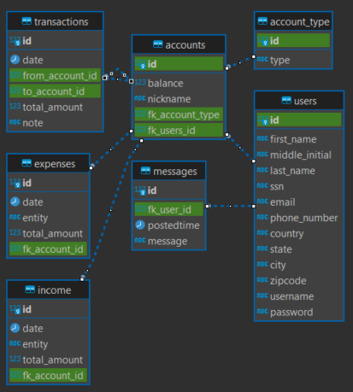
ERD Diagram
Notes:
David

Slide 8
Implemented Features
Open Account
Register
Login/Logout
User Profile
Track Multiple accounts
Transfer Money Between Accounts
Track Income and Expenses
Send Money
Dark Mode
Notifications
Notes:
Josiah

Slide 9
Challenges Faced
Unit Testing
Spring
Implementing Other APIs
Notes:
Yasin

Slide 10
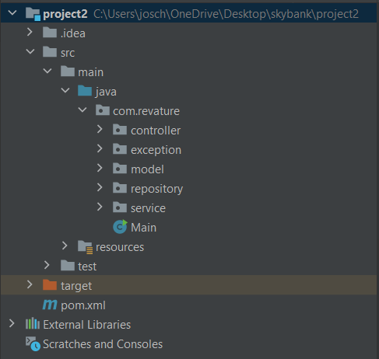
Backend Demo

Slide 11
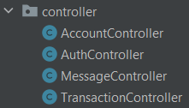
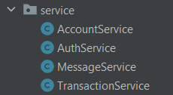
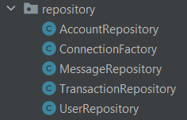
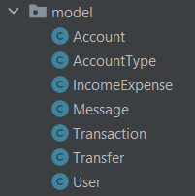
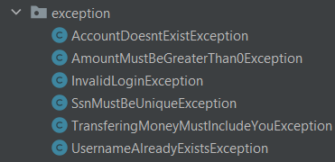
Backend Demo

Slide 12
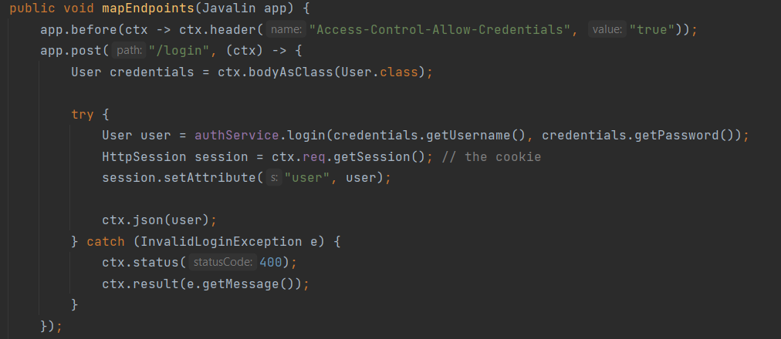
Backend Demo

Slide 13
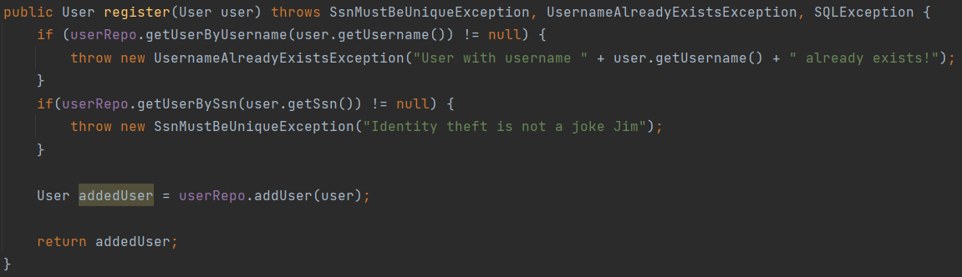
Backend Demo

Slide 14
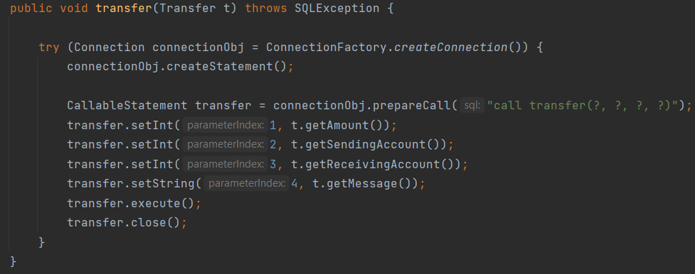
Backend Demo

Slide 15
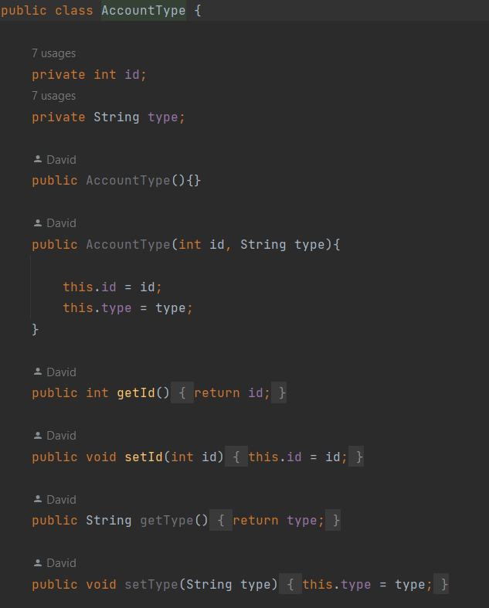
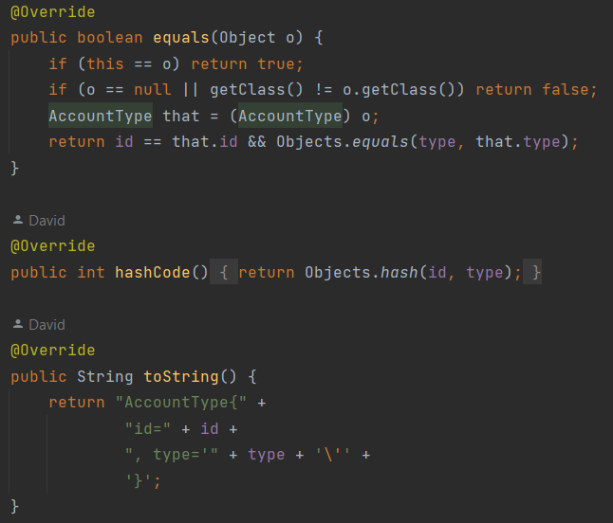
Backend Demo

Slide 16
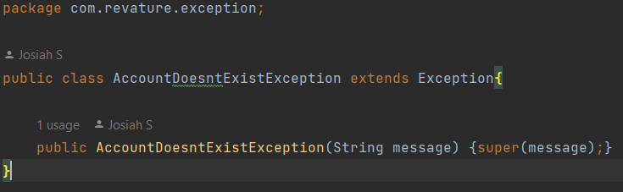
Backend Demo

